Slide 1
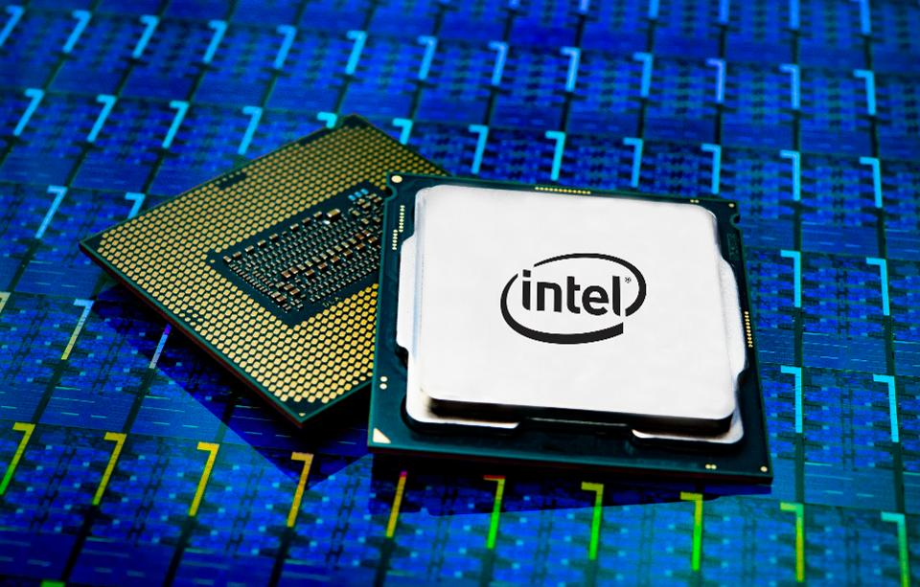
Intel Micro-Architecture (Ice Lake/Sunny Cove)
Goal: Fast overview of one of Intel’s main processors
Highlights:
Superscalar
Speculative Execution
Register Renaming
14-deep pipeline
A bit of x86 instruction set

Slide 2
X86 Milestones – Evolution of the instruction set
Some relevant steps (not all):
1974: 8080 8-bit, 2MHz, 6k transistors
1978: 8086 16-bit, 5-10MHz, 29k transistors
1980: 8087 floating point coprocessor
1982: 80286 16-bit, 6-12.5MHz, 134k transistors, 24-bit address space
1985: 80386 32-bit, 16-33MHz, 256k transistors, 256B code cache
1989: 80486 32-bit, 25MHz, 1.2M transistors, 8KB L1, 5-stage pipe
1992: Pentium 32-bit, 60-66MHz, 3.3M transistors, 16KB L1, L2, branch predict, superscalar (CPI=0.5).
1995: Pentium Pro, 32-bit, 200MHz, 5.5M transistors, CPI=1/3, 12-stage pipeline, out-of-order execute, predicated instructions, 4-bit branch history.
1996: Pentium MMX, 150-233MHz, 4.5M transistors, SIMD (single instruction multiple data) instructions.
2000: Pentium 4, 1.3-3.0GHz, 42M transistors, 20-deep pipeline, symmetric multithreading
2006: Core 2 Duo, 64-bit, 1.0-2.3GHz, 291M transistors, 14-stage pipeline, multi-core
2008: Nehalem/i7, 1.73-3.46 GHz, 2.6B transistors, quad/octo-core, SMT, shared L3
2013: Haswell/i7, 1.9-4.6GHz, 1.4B transistors, 2-8 cores, on-die GPU, 2 branch units
2019: Ice Lake/Sunny Cove …
Backwards compatible

Slide 3
X86 Operands
16x64-bit registers plus special-purpose registers (Flag, segments, etc).
2-operand instructions:
Multiple data memory addressing modes:
Source/Destination operand Type | Second source operand
Register | Register
Register | Immediate
Register | Memory
Memory | Register
Memory | Immediate
Mode | Description
Register Indirect | Mem[Reg[id]]
Base + 8/32/64-bit displace | Mem[Reg[id]+displace]
Base + scaled index | Mem[Reg[id]+Reg[id2]*2^{scale}], scale=0..3
Base + scaled + 8/32/64 displace | Mem[Reg[id]+Reg[id2]*2^{scale}+displace]

Slide 4
Instructions
Data movement: Move, push, pop
Arithmetic & logic: test, integer, decimal math, etc.
Control Flow: conditional & unconditional jumps, calls, returns
String instructions: string move, compare (legacy from 8080, not much used)
Streaming SIMD (MMX, SSE)
Single instruction, multiple data (i.e. 4x8-bit adds simultaneously)
Intended for multi-media

Slide 5
Instruction Encoding
Range from 1-byte to 17-byte!
Opcode says bitwidth of 8-bit/32-bit…
May have extra byte to indicate addressing mode
Extra byte for scaled index mode.
Stack Operation (PUSH)
Conditional Branch (JE)
LDUR/STUR (MOV)
5
3
4
4
8
6
2
8
8
PUSH
Reg
JE
Cond
Displace
MOV
type
AddrMode
Displace
Branch w/link (CALL)
ADDI (ADD)
8
32
4
3
1
32
CALL
Offset
ADD
Reg
w
Immediate
Set flag with AND (TEST)
7
1
8
32
TEST
w
AddrMode
Immediate

Slide 6
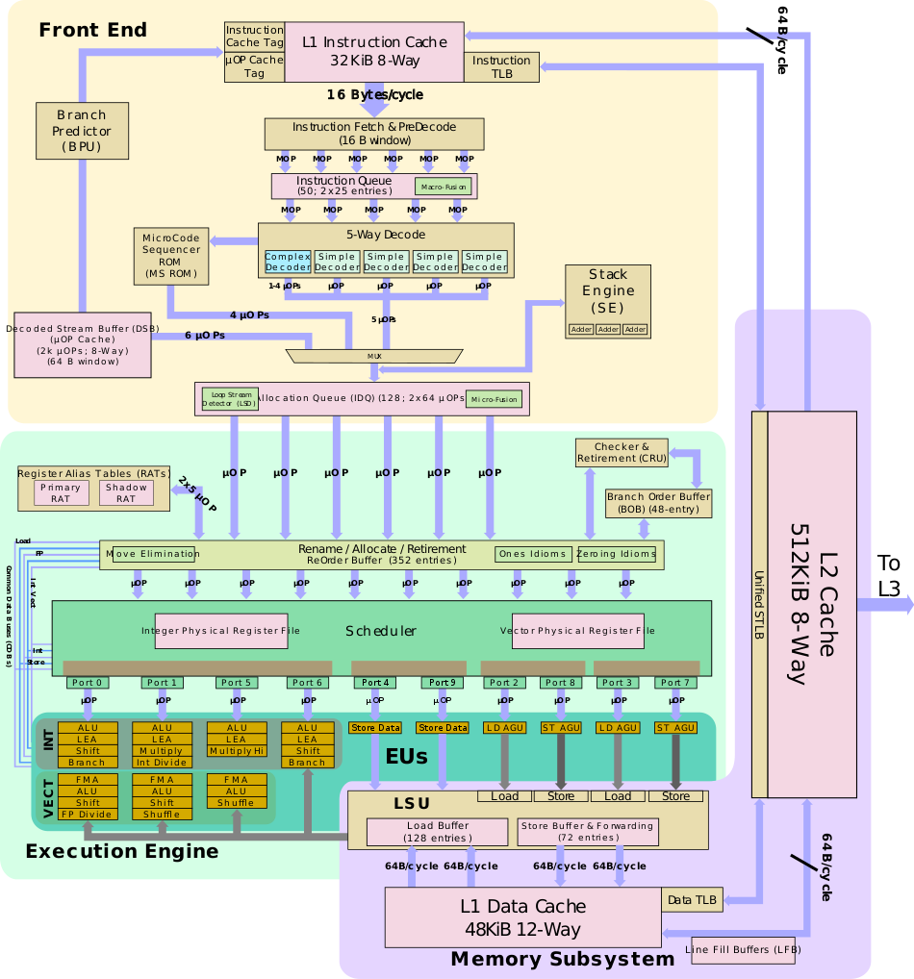
Instruction Decoding
X86 instructions are essentially pseudo-instructions, converted to multiple RISC-like micro-ops
CPU decodes X86 into micro-ops at runtime
Picture from David Schor, wikichip.org

Slide 7
Instruction Scheduling
Picture from David Schor, wikichip.org

Slide 8
ALUs
Picture from David Schor, wikichip.org

Slide 9
Parallelism
CPU is ~8-way superscalar, ~14 pipeline stages (P4 had 20!)
Superscalar picks from 352-Instruction window.
Register renaming to 180 registers.
Each chip has 2-4 cores
Symmetric Multithreading (2-way per core)
On-chip GPU

Slide 10
Cache Organization
All 64 byte blocks, write-back.
(Per core) Split L1 Caches
32KB, 8-way Set Associative Instruction Cache
Can fetch 16B/cycle.
48KB, 12-way Set Associative Data Cache
5-cycle latency. 128B/cycle loads & stores.
(Per core) L2 Unified Cache
512KB, 8-way Set Associative
non-inclusive
13-cycle latency
(Per-chip) L3 Unified Cache
up to 8MB, 16-way Set Associative
inclusive
~36-cycle latency

Slide 11
Pipeline
14-19 stages

Slide 12
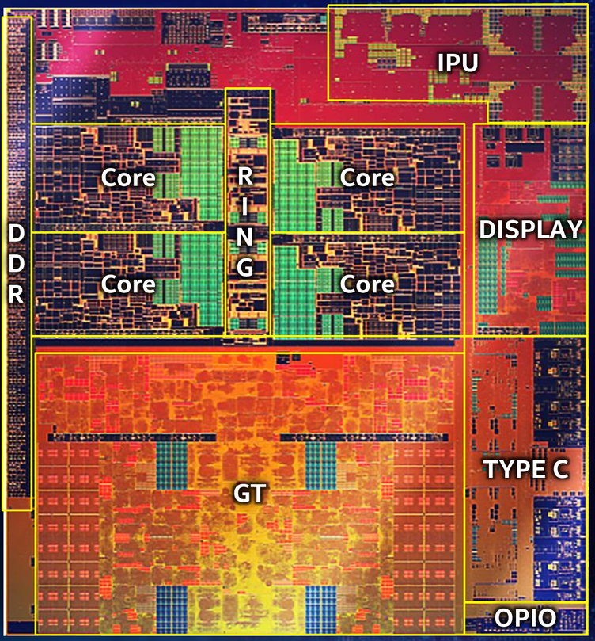
Layout
Core: CPU
RING: interconnect
GT: GPU
Type C: I/O port
Display: Display driver
IPU: Image Processing Unit
OPIO: on-package I/O
DDR: Memory interface

Slide 13
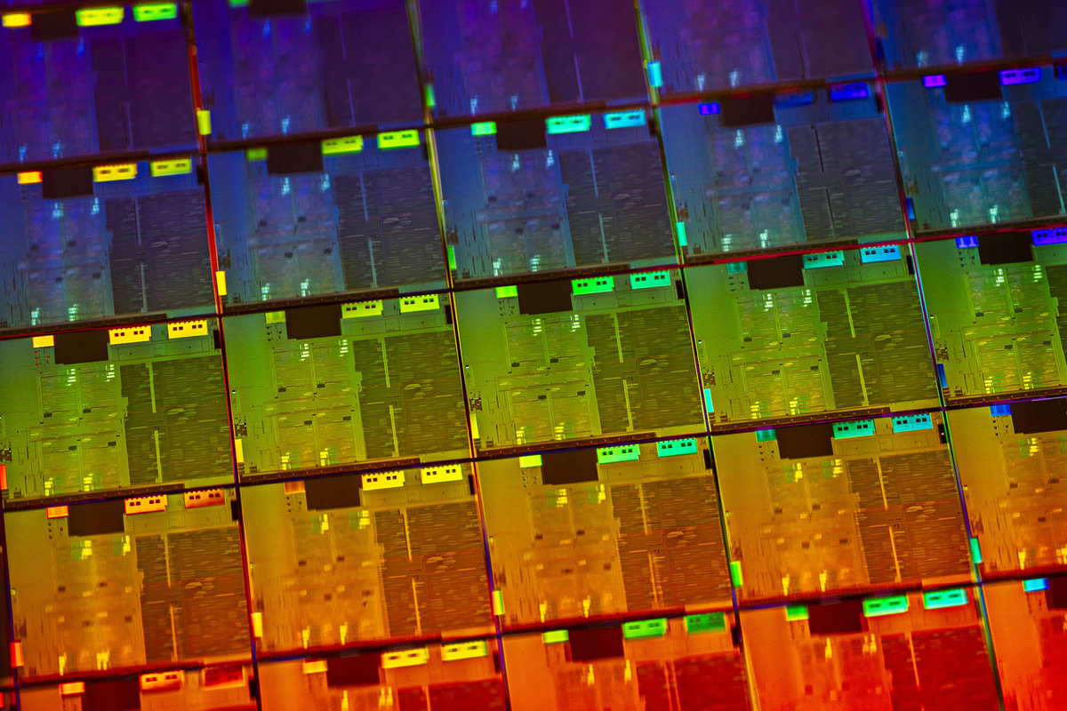
Intel Ice Lake Die

